Slide 1
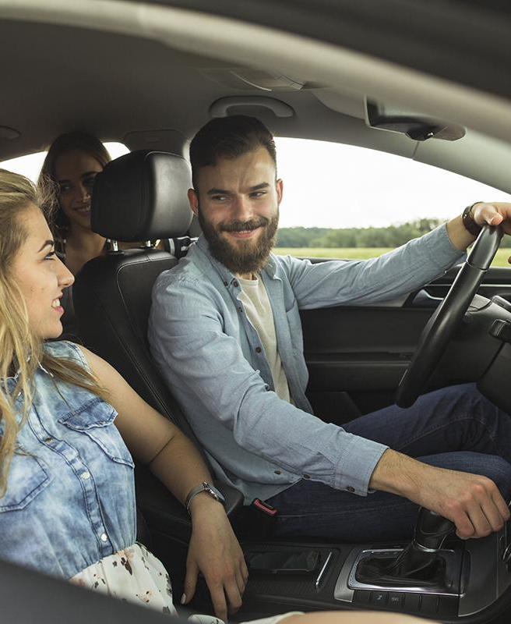
Aspetos Profissionais
e Sociais do Projeto em Informática
Raquel Paradinha 102491
Paulo Pinto 103234
Miguel Matos 103341
Filipe Antão 103470
Tiago Carvalho 104142

Slide 2
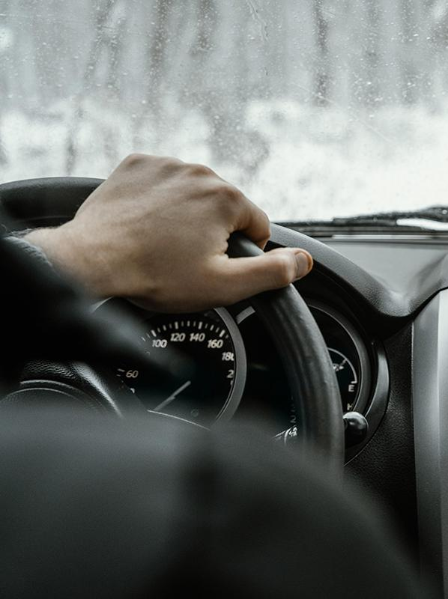
Context
Notes:
Trabalho desenvolvido no contexto de PI
a Virtual Vehicular Communications Unit as a Cloud-Native Network Function
A condução cooperativa pode melhorar significativamente o paradigma dos Sistemas de Transporte Inteligente.
Ao permitir que os veículos autônomos negociem as suas manobras em vez de depender apenas de suas próprias funções sensoriais.
Use cases:
conhecimento situacional
coordenação de manobras
Através da comunicação entre veículos e estações físicas
No entanto, a coordenação de manobras requer uma quantidade significativa de troca de mensagens, o que pode sobrecarregar a rede 5G.
Aproveitando os benefícios da Multi-Access Edge Computing (MEC), podemos virtualizar as VCUs dos veículos/estações, criando réplicas digitais dessas unidades.
Dessa forma, podemos realizar essas negociações a uma distância digital menor, reduzindo a sobrecarga e a latência das comunicações.
Podemos levar isso ainda mais longe migrando as réplicas digitais para o mesmo MEC, reduzindo a latência da rede e acelerando o processo de coordenação de manobras.
No entanto, esta abordagem ainda tem uma limitação quando os DTs são deployed em MECs diferentes, o que resolvemos através da migração dos mesmos.

Slide 3

01
ECOSYSTEM

Slide 4
SUPPLIERS
MECs
5G and Cloud Infrastructure
WHAT WE NEED?
National Telco Operators
Telecommunications and Cloud Services Suppliers
Notes:
MECs:
Altice
NOS
Vodafone
Huawei
5G:
os mesmos de cima
(Para hosting na cloud de componentes do projeto como o Manager e o Orchestrator, que não precisam de estar na edge.)
AWS
Microsoft Azure

Slide 5
CLIENTS
AUTOMOTIVE INDUSTRY
ITS PROVIDERS
RESEARCH INSTITUTIONS
Autonomous vehicles manufacturers benefit from CCAM applications
Testing and developing environment for their own projects
Collaborating to reach new technologies and techniques

Slide 6
COMPETITORS
Technology Companies
Research Institutions
Automotive Manufactures
Tech industry want to invest in the future
This institutions are always on the front in studies with new technologies like ours
This companies live for this industry, they probably have investigations on this area

Slide 7
REGULATORY FRAMEWORK
UNECE
ISO
United Nations Economic Commission for Europe
International Organization for Standardization
Notes:
No âmbito regulatório, existem diferentes camadas e organizações envolvidas.
A nível global, organizações como a Comissão Económica das Nações Unidas para a Europa (UNECE) e a Organização Internacional de Normalização (ISO) estabelecem normas e diretrizes para a implementação de sistemas CCAM a nível internacional.

Slide 8


SCALE EFFECT
IMPROVED TRAFFIC EFFICIENCY
ENHANCED ROAD SAFETY
OPTIMAL INFRASTRUCTURE UTILIZATION
INNOVATION AND CONTINUOUS EVOLUTION
Notes:
O crescimento do nosso produto no mercado levaria a um aumento no financiamento direcionado a este ramo de investigação, que se traduziria na prática em:
maior eficiência de tráfego automóvel
maior segurança rodoviária
melhor gestão dos recursos disponíveis, assim como um aumento destes
evolução contínua

Slide 9
02
Possible
Patents

Slide 10
03
Open Source Technologies

Slide 11
Technologies used
Open Source MANO
Kubernetes
Mosquitto
Used to orchestrate and migrate our Digital Twins. Falls under Apache 2.0 License
Used to simulate our different MECs. Falls under Apache 2.0 License
Used to implement our message brokers. Falls under EPL License
Notes:
https://www.flaticon.com/packs/driving-school-86?word=car

Slide 12
04
CYBERSECURITY

Slide 13
CIBERSECURITY
DATA PRIVACY
VEHICLE COMMUNICATION
SOFTWARE AND FIRMWARE SECURITY
The data collected will be put through robust data privacy measures to protect this information from unauthorized access or misuse.
Data sent by the vehicles can be intercepted, this kind of communication must be secure
All the software and firmware should be regularly updated to present abuses in vulnerable versions.

Slide 14
05
THREATS

Slide 15
THREATS
MITM
INSIDER THREATS
DOS
ZERO-DAY EXPLOITS
Gets between the sender and the receiver
People with bad intents inside the system can cause harm to it
Overloads the whole system making it useless
Attacks that are not known to the public

Slide 16
06
DATA PRIVACY &
SECURITY

Slide 17
Potentially Collected Data
CAR PLATES
PEDESTRIANS FACES
Personal data not used or treated
Personal data used
LOCATION
Notes:
the dts do not process any data from the physical units themselves they make it available to other applications that belong to the system it integrates
if this data is sensitive, the system should be designed to handle it properly, regarding privacy and security
however, that twins themselves should not be a weak spot in the system
we can indulge our mind with the possibilities
potential data collected:
plates, faces through pictures, locations/usual routes
ways to deal with this: consent/conform to regulations data anonimization - location might not need to be linked to its corresponding user

Slide 18
07
SYSTEM RECOVERY

Slide 19
SYSTEM RECOVERY
INCIDENT RESPONSE
TRANSPARENCY
FORENSIC INVESTIGATION
REMEDIATION AND RECOVERY
SECURITY MEASURES
MONITORING & READINESS
Have team ready to quickly respond to this event
Notify everyone affected by the attack, and what will be done
Identify the root of the attack, vulnerabilities and gather legal evidences
Develop a plan of action to deal with the vulnerabilities exposed by this attack
Upgrade our security measures to prevent this attack again
Keep monitoring everything in order to be ready to respond quickly
Notes:
segurança no sistema não está apenas em prevenir os problemas, mas também na forma como lidamos com eles quando estes inevitavelmente surgem
prevent using authorization, encryption, etc
recover using: (in ppt)

Slide 20
08
ETHICAL ASPECTS

Slide 21
ETHICAL ASPECTS
TRANSPARENCY
ONLY NECESSARY DATA
The users must know every data we will be collecting and the where/how they will be used
Only the strictly necessary data will be gathered and used

Slide 22
09
ARTIFICIAL INTELLIGENCE

Slide 23
ARTIFICIAL INTELLIGENCE
AI has no effect on our solution, but it can be implemented within other works which can use it.
We need into take in account the moral aspects within the integration of our project

Slide 24
10
HYPERSCALERS

Slide 25



HYPERSCALERS
AWS
MICROSOFT
AZURE
IBM CLOUD
Amazon’s costumer base and cloud service’s experience
Azure services focused on IoT and data analysis
IBM’ edge computing experience

Slide 26
11
NETWORK EFFECTS

Slide 27
POSITIVE EFFECTS
User Adoption
Compatibility & Interoperability
Developer Ecosystem
Partnerships
Satisfied users bring more users
Good compatibility and interoperability brings value to the solution
Giving developers need are included in our concerns
Partnerships can take
our solution to light

Slide 28
NEGATIVE POINTS
Quality Deterioration
Negative Feedback Loops
One user’s negative experience can repel more people
Rapidly expanding the range of user is not ways the correct move
Notes:
QUALIDADE DECRESCENTE
crescimento rápido
incapacidade de satisfazer esse crescimento
aumento da insatisfação
aparecimento de maus efeitos de rede
NEGATIVE FEEDBACKS
mesmo da anterior mas aqui o user importa
um user insatisfeito, ainda por cima se for de importance
propagação da insatisfação
aparecimento de maus efeitos de rede

Slide 29
THANKS FOR YOUR ATTENTION

